Slide 1
Welcome to My presentation
Team Members:
Shoaib Ahmad
Sakib Hasan
Naim Hossain

Slide 2
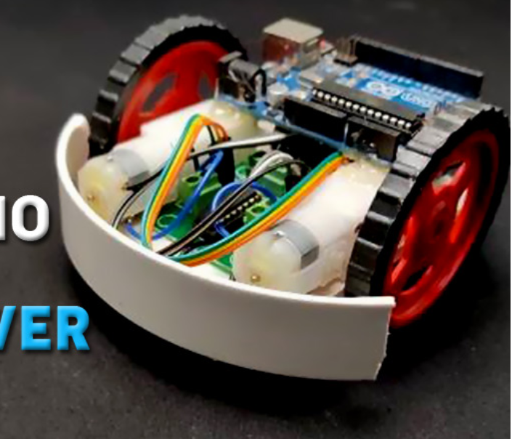
Line Follower Robot using Arduino Uno
Line Follower Robot (LFR) is a simple guided robot that follows a line drawn on the ground to detect a dark line on a white surface or a white line on a dark

Slide 3
Working of a Line Follower Robot
A line, robot must detect the line first.
IR sensor can be used. To detect the line,
Two IR sensors one on the left and one on the right side.
We then place the robot on the line such that the line lies in the middle of both sensors.
Infrared sensors consist of two elements, a transmitter and a receiver. which produces the signal.

Slide 4
How does a Line Follower Robot Navigates?
line follower robot has two sets of motors, let's call them left motor and right motor.
Both motors rotate on the basis of the signal received from the left and the right sensors.
The robot needs to perform 4 sets of motion
forward, turning left, turning right and Stop

Slide 5
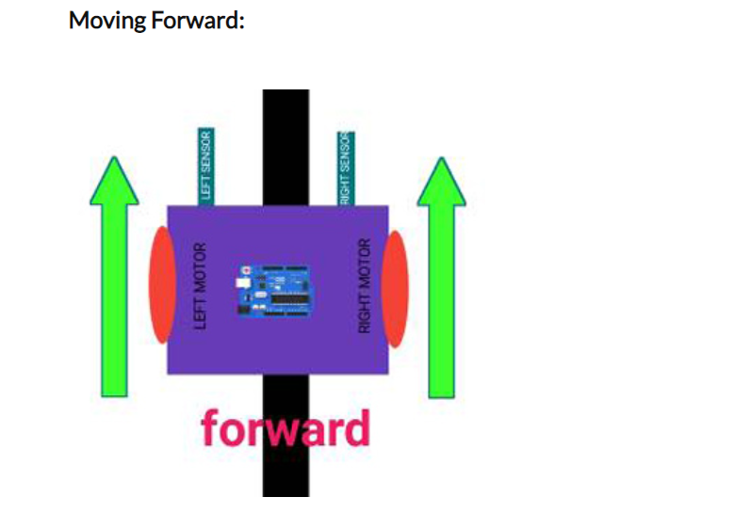
Moving Forward:
when both the sensors are on a white surface and the line is between the two sensors, the robot should move forward

Slide 6
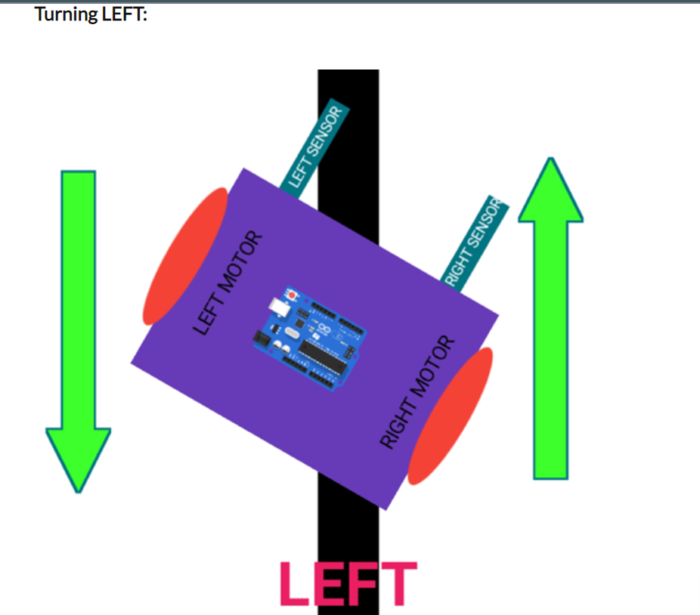
Turning left
In this case, the left sensor is on top of the dark line, whereas the right sensor is on the white part, here the left sensor detects the black line and gives a signal

Slide 7
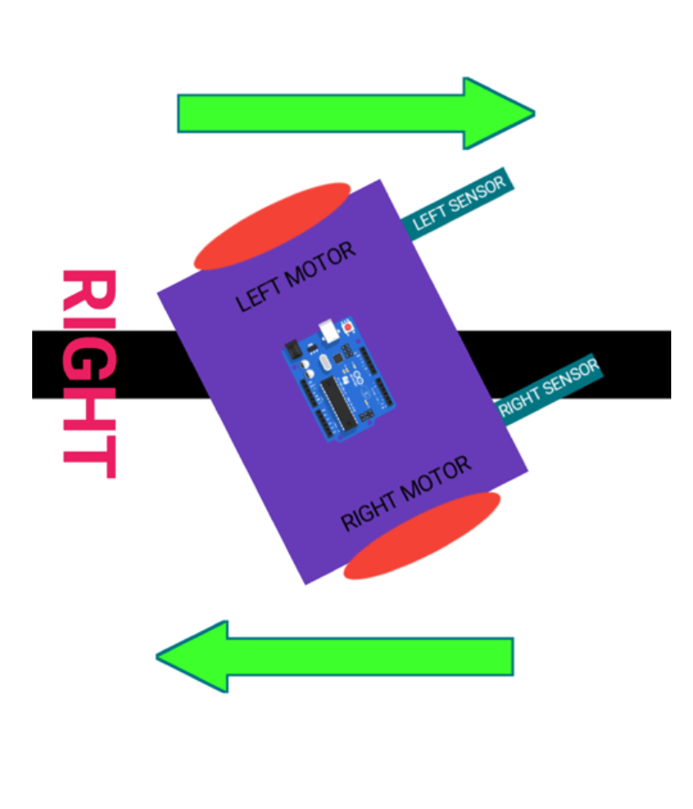
Right sensor
This case is similar to the left case, but in this situation only the right sensor detects the line which means that the robot should turn in the right direction.

Slide 8
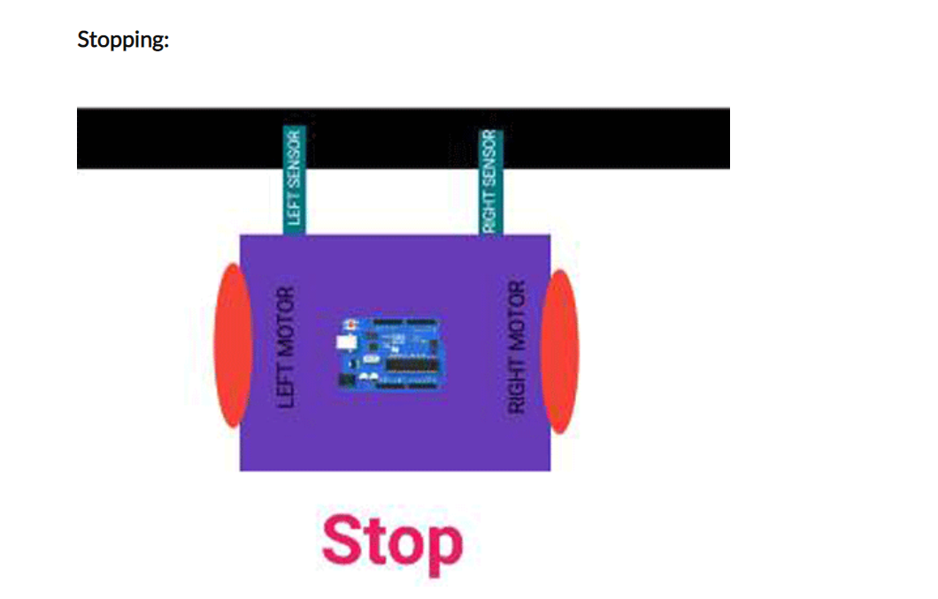
Stopping:
In this case, both the sensors are on top of the line and they can detect the black line and stop

Slide 9
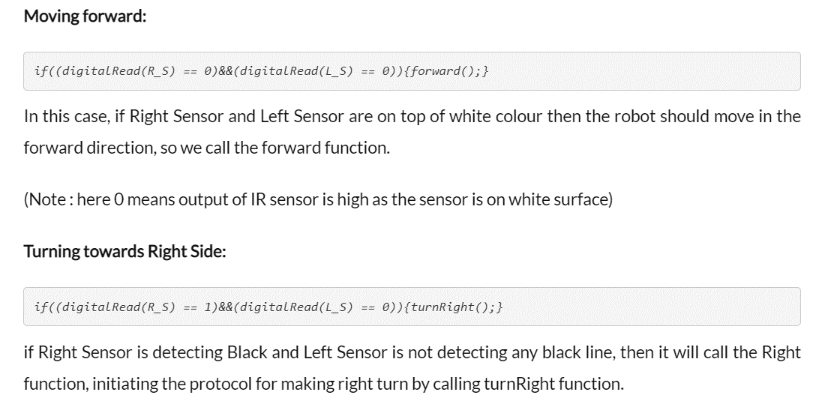

Slide 10
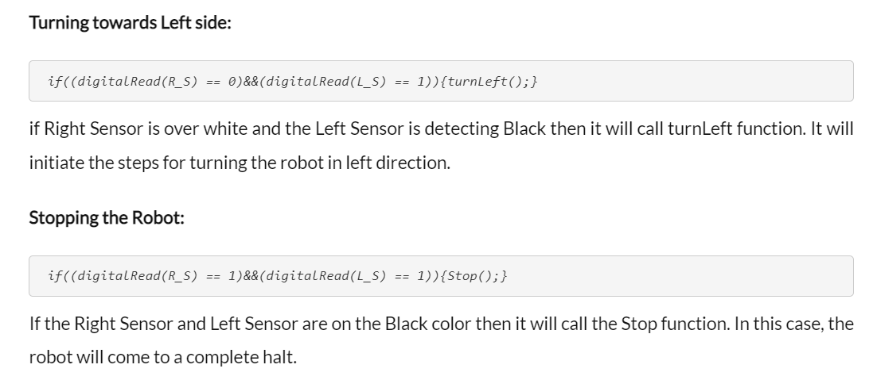

Slide 11
Components Required for Making Arduino Line Follower Robot
Arduino Uno - 1
L293D motor driver- 1
IR sensor module -2
7.4 or 9V battery -1 Nos
motor - 2
Motor wheel - 2 Nos
robot chassis - 1 Nos
Wires

Slide 12
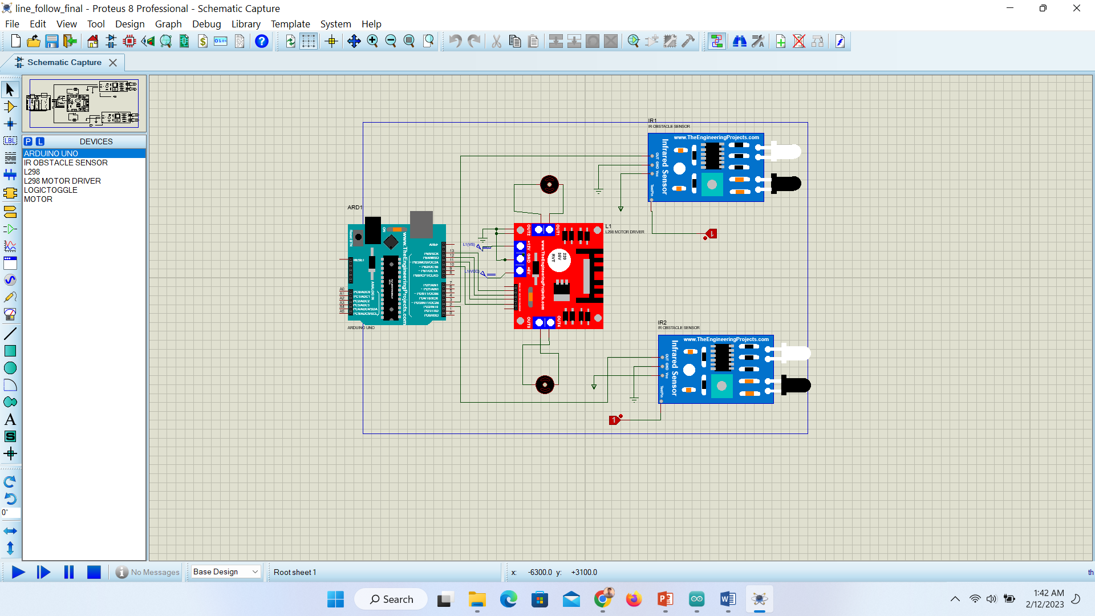

Slide 13
Thank you
The End

